Slide 1
Developing executives and managers in Swedish Central Government administration
A presentation at EUPAN/HRWG in Cyprus 15th October 2012
Per Stengård
Senior Adviser
Per.stengard@arbetsgivarverket.se

Slide 2
Delegated responsibilities and decentralised structure
The government office carries the responsibility for recruiting and developing 204 heads of agencies
A short presentation will follow
Each agency carries the responsibility for finding, recruiting and developing all 15 000 managers below heads of agencies. Larger agencies have their own programmes
Short examples from the Police and the Employment office will follow

Slide 3
Heads of Agencies
Are appointed by the government for 6 + 3 years
Are leading their agency’s operations to ensure
Fulfilment of political priorities
Good control of finances and
Effective use of resources (staff, localities, technology)
Are representing their organisation internally and externally
As a representative for the state they shall promote the image of the central government as an attractive employer

Slide 4
A two pillar programme for Heads of Agencies
General introduction and development programme, planned and provided by the government office
Specific introduction and development programme, planned and provided by each ministry in charge

Slide 5
General introduction and development, planned and provided by the government office A:
Information about personal conditions and the development programme
Seminar about how the administration works, the budget and economic steering process, employer responsibilities, ethics and the role as government official (1 day)
Training in leadership, its demands and possibilities, in the context of central government administration (6 full days)

Slide 6
General introduction and development, planned and provided by the government office B:
Participation in development groups for professional guidance in managerial skills (4 times during a year)
Possibility to join a continued network of 7-8 executives in support of a professional consultant
Continued seminars in different subjects
Individual skills training (language, media training etc.)

Slide 7
National management and leadership development in
the Swedish Police

Slide 8
The programme design process
National Police Board/HR
Identify
needs
for
activities
Ordering and
evaluating
activities
The local
Police authorities
The Leadership center
Implementation

Slide 9
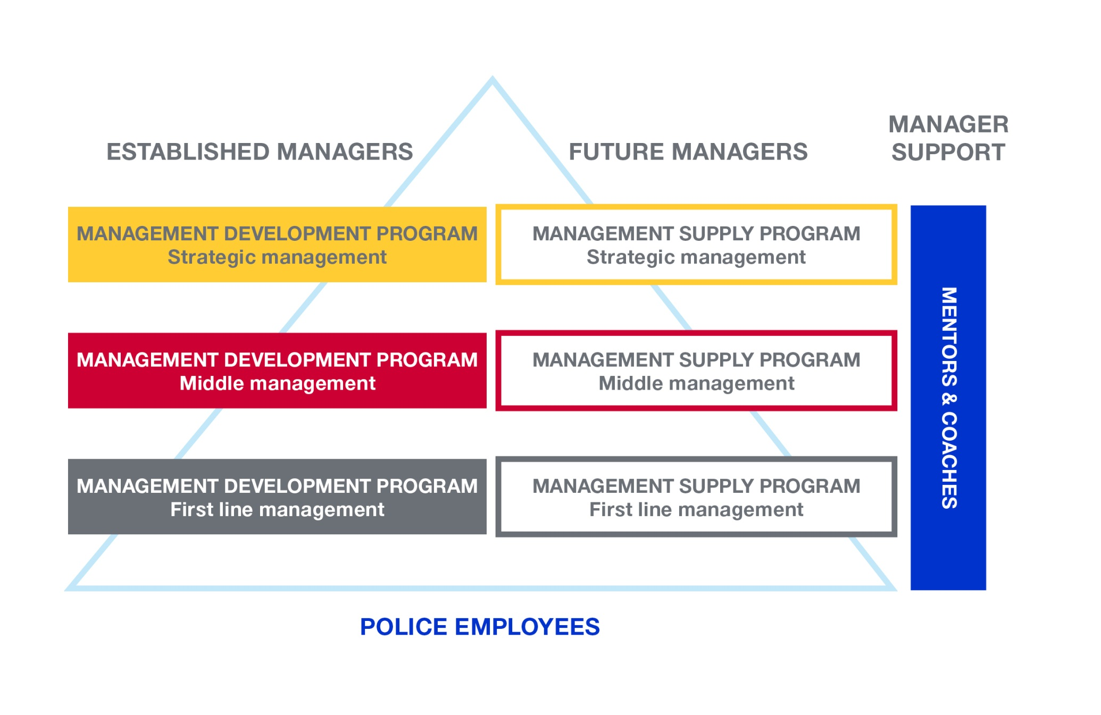

Slide 10
Management development program – First line management
Target group
Managers who perform leadership directly to employees
Aim
Increase knowledge about the steering mechanisms in the Swedish police force and the ability to accomplish results through others
Structure
Six months of university studies at 15% study rate
Large group interventions
Distance learning via Internet
Leadership training

Slide 11
Management development program- Middle Management
Target group
Managers who perform leadership to other managers
Aim
Establish the basics of administrative and labour law
Increase the ability to lead managers and develop effective management teams
Master organizational issues and the communication flow in the organization
Structure
Two years of university studies at 25% study rate
Distance learning via Internet
5 seminars of each 4 - 5 days

Slide 12
Management development program- Strategic management
Target group
Management with focus on overall strategic consideration
Aim
Increase the ability to manage change processes and quality management
Structure
18 months of university studies
Distance learning
9 seminars of each 3 days

Slide 13
The Police Executive Programme
Content
Criminological theories
Leadership & Management
Evidence-based policing
Methods for research and analysis
Structure
Three seminars of each two weeks at the University of Cambridge
Three essays
Loading extensive litterature
Supervisors

Slide 14
Evaluation of the Police programme
The Ministry of justice demands a yearly report on the benefits of the programme.
Participants assess the programme as very good
The possibility to use new knowledge may be discussed
Ramböll Management has got the commission to evaluate the full programme

Slide 15
Example 2:The Swedish Employment Service Agency
Management maintenance strategy
13000 employees
550 managers
Attract
Identify
Prepare
Recruit
Introduce
Develop
Keep
Complete

Slide 16
Identifying (potential) managers
(On the labour market)
Already employed
Interviewing managers
Search for empirical proof (relevant experience, responsibilities etc.)
Testing
Selecting
Attract
Identify
Prepare
Recruit
Introduce
Develop
Keep
Complete
An excellent professional does not always have the capacity to become a well performing manager

Slide 17
Local identification
Trying leadership
Managers assess potential leadership skills for operational or strategic level
Identification centre
Personality test
Skills test
Simulation
Structured interview
Three part dialogue (local manager, tester, employee)
Potential for leadership?
Written development plan
Attract
Identify
Prepare
Recruit
Introduce
Develop
Keep
Complete

Slide 18
Introducing new managers
At the workplace
Understanding the assignment and the expectations
Identifying specific tasks
Identifying competences needed
Establishing good knowledge in the field of responsibility
Establishing and deepening knowledge about staff
Creating a good communication with staff, superiors, colleagues and other stake holders
Creating a personal development plan for the new manager
Attract
Identify
Prepare
Recruit
Introduce
Develop
Keep
Complete

Slide 19
Introducing new managers cont.
By means of a set of educations during 2 years
The first year of management, partaking in education modules:
Being a manager
Economy skills
Relevant law
Operational dialogue skills in the Employment Service
Communication skills
Developing work environment
Safety and crisis management
The second year of management focuses leadership development education in five modules
Values, group creation, conflict management, communication, staff development, follow up etc.
Attract
Identify
Prepare
Recruit
Introduce
Develop
Keep
Complete
Two times 360 degree follow up

Slide 20
Further development of managers
Leadership for staff’s personal growth
Programme for experienced managers
Programme for higher executives
Yearly “managers day” (at several levels)
Smaller meetings for managers
Coaching
Mentorship programmes
Career advice
Attract
Identify
Prepare
Recruit
Introduce
Develop
Keep
Complete

Slide 21
In summary
The very top executives are the responsibility of the Government and its office
All other executives and managers are the responsibility of the single agencies as employers
Maintenance and development programmes are increasingly coming into use as the three examples has shown
Larger agencies create an administrative structure for this

Slide 22
Thank you!
For further information please contact:
Police:
Max Lutteman max.lutteman@polisen.se
Employment Service Agency:
Thomas Ekberg thomas.ekberg@arbetsformedlingen.se

